Slide 1
Testing and Debugging

Slide 2
Program Errors
Compiler errors (syntax errors)
Runtime errors
Logic errors

Slide 3
Compiler Errors
Syntax errors
Errors in usage of Java
Detected by the compiler
A program with compilation errors cannot be run
Syntax warning
Warning message generated by the compiler
The program can be run

Slide 4
Compiler Errors
Very common (but sometimes hard to understand). Examples of syntax errors:
Forgetting a semicolon
Leaving out a closing bracket }
Redeclaring a variable

Slide 5
Compiler Errors
Hints to help find/fix compiler errors:
Compiler errors are cumulative: when you fix one, others may go away
Read the error messages issued by the compiler
Realize that the error messages from the compiler are often (seemingly) not very helpful
The compiler does not know what you intended to do, it merely scans the Java code

Slide 6
Runtime Errors
Runtime errors: program runs but gets an exception error message
Program may be terminated
Runtime errors can be caused by
Program bugs
Bad or unexpected input
Hardware or software problems in the computer system (very rare)

Slide 7
Runtime Errors
Very common runtime errors are:
Null reference (NullPointerException)
no object is referenced by the reference variable, i.e. it has the value null
Array index out of bounds (ArrayIndexOutOfBoundsException)
We will talk later about exceptions.
Running out of memory
e.g. from creating a new object every time through an infinite loop

Slide 8
Runtime Errors
Hints to help find/fix runtime errors:
Check the exception message for the method and line number from which it came
Note that the line in the code that caused the exception may not be the line with the error
Example: consider the code segment int [] nums = new int[10]; for (int j=0; j<=10; j++) nums[j] = j;
The exception will be at the line nums[j] = j; but the error is in the previous line

Slide 9
Logic Errors
Logic errors: program runs but results are not correct
Logic errors can be caused by:
Incorrect algorithms. These errors are the most difficult to fix. It is very important that you spend sufficient time designing your algorithms and making sure they are correct before you implement them in Java.

Slide 10
Logic Errors
Common logic errors are:
using == instead of the equals method
infinite loops
misunderstanding of operator precedence
starting or ending at the wrong index of an array
If index is invalid, you would get an exception
misplaced parentheses (so code is either inside a block when it shouldn’t be, or vice versa)

Slide 11
Logic Errors
Be careful of where you declare variables.
Keep in mind the scope of variables
Example: private int numStudents; // an attribute, to be // initialized in some method
… public void someMethod(){ int numStudents = …; // not the instance variable!
…
}

Slide 12
Testing vs Debugging
Testing: to identify any problems before software is put to use
“Testing can show the presence of bugs but can never show their absence”.
Debugging: locating bugs and fixing them

Slide 13
Hints for Success
When writing code:
Make sure your algorithm is correct before you start coding.
Start small:
Write and test first simpler methods (e.g. getters, setters, toString)
Then write and test each of the more complex methods individually
Check your code first by a preliminary hand trace
Then try running it

Slide 14
Debugging Strategies
Trace your code by hand
Add main method to the class
Add print statements to your code
Use a debugger

Slide 15
Tracing by Hand
Tracing by hand
Good starting point for small programs or simple methods
Problem: sometimes you do what you think the computer will do, but that is not what it actually does
Example: you may write that int i = 9/5; assigns to i the value 1.8, but it is really 1
Hint: draw diagrams of reference variables and what object(s) they are pointing to.

Slide 16
Adding a main Method
Adding a main method to the class
Conventionally placed at the end of the class code, after all the other methods
What are the advantages of having the test harness (main method) right in the class, rather than creating another class that is just a test program?

Slide 17
Using Print Statements
Using print statements
Insert System.out.println() statements at key locations:
to show values of significant variables
to show how far your code got before there was a problem
In the print statement, it’s a good idea to specify
The location of the trace (what method)
The variable name as well as its value

Slide 18
Debuggers
All Integrated Development Environments have an interactive debugger feature
You can single-step step through your code (one statement at a time)
You can see what is stored in variables
You can set breakpoints
You can “watch” a variable or expression during execution

Slide 19
Defensive Programming
Write robust programs
Include checking for exceptional conditions; try to think of situations that might reasonably happen, and check for them
Examples: files that don’t exist, bad input data
Generate appropriate error messages, and either allow the user to reenter the data or exit from the program
Throw exceptions (we will cover this topoc later)

Slide 20
Introduction to Eclipse’s Debugger

Slide 21
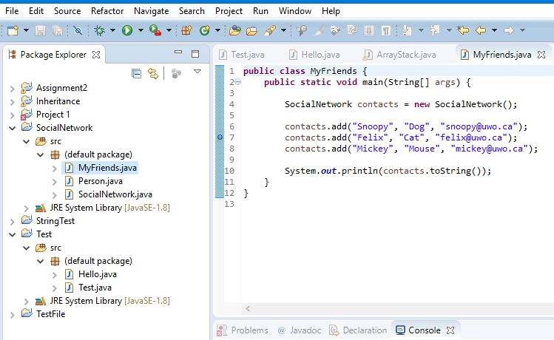
Debugging a Program
1. Add breakpoints: double-click the blue bar on the left side of Edit window or right click on the bar and select “toggle breakpoint”. A blue dot indicates a breakpoint. To remove a break point, double click the breakpoint.
A break point

Slide 22
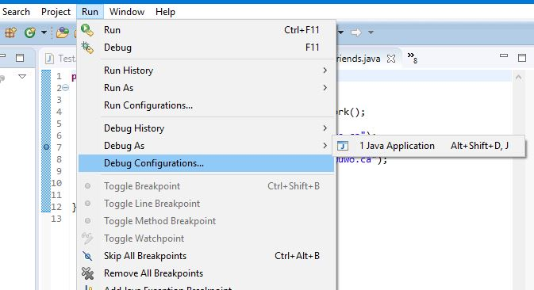
2. Select Run->Debug as...->Java Application to start the debugger.
If asked, accept to switch to debug Perspective.

Slide 23
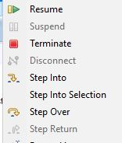
4. Click on Run and then try the debug commands to see what they do and see how the values of the variables change in the Variable window and what the outputs are in the Console window.
Resume resume the execution of a paused program.
Suspend temporarily pause the execution of a program.
Terminate end the current debug session.
Step Into execute a single statement or step into a method.
Step Into Selection While debugger is stopped on a break point, put cursor
on a method you want to step into
Step Over execute a single statement. If the statement contains a call
to method, the entire method is executed without stepping
into the method.
Step Return execute all the statements in the current method and returns
to the caller.

Slide 24
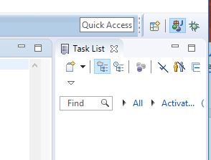
5. Switch Eclipse from Debug Perspective back to Java Perspective.
Click on the Java Perspective button

